Slide 1

Chapter 6
Getting User Input with Forms

Slide 2
Learning Objectives
Use the <form> and </form> tag pair to define an HTML-based form
Use the <input> tag to create a text box for user input within a form
Use the <input> tag to create radio buttons which simplify user selection within a form
Use the <input> tag to create checkboxes to allow users to select multiple options within a form
Use the <input> tag to create a button within a form
Use the <select> and </select> tag pair to define a pull-down list within a form
Use the <textarea> and </textarea> tag pair to prompt the user for large amount of text within a form.
Group related input fields within a form

Slide 3
Learning objectives continued
Group related items within a pull-down list
Submit a form’s contents to a remote script
Compare and contrast server-side script validation of a form’s data with client-side JavaScript validation

Slide 4
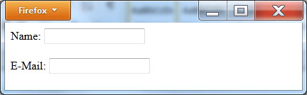
Simple form – prompt only – no action
<!DOCTYPE html> <html> <body> <form> Name: <input type="input" name="username"/> <br/><br/> E-Mail: <input type="input" name="e-mail"/> </form> </body> </html>

Slide 5
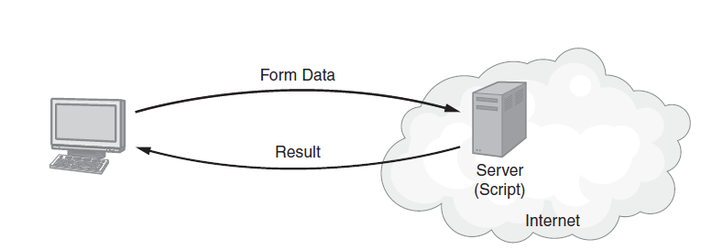
Submission process

Slide 6
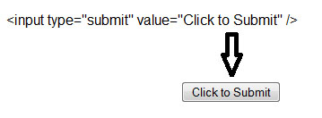
Button, but still no submit
<!DOCTYPE html> <html> <body> <form> Name: <input type="input" name="username"/> <br/><br/> E-Mail: <input type="input" name="e-mail"/> <br/><br/> <input type="submit" value="Click to Submit" /> </form> </body> </html>

Slide 7
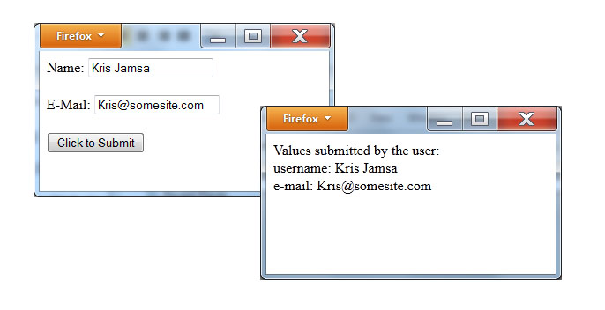
Specifying the submit action
<!DOCTYPE html> <html> <body> <form action="http://www.WebsiteDevelopmentBook.com/FormEcho.php" method="post"> Name: <input type="input" name="username"/> <br/><br/> E-Mail: <input type="input" name="e-mail"/> <br/><br/> <input type="submit" value="Click to Submit" /> </form> </body> </html>

Slide 8
Formecho.php
<?php $msg="Values submitted by the user:<br>"; foreach($_POST as $key => $val){ if (is_array($val)){ $msg.="Item: $key<br>"; foreach($val as $v){ $v = stripslashes($v); $msg.=" $v<br>"; } } else {
$val = stripslashes($val); $msg.="$key: $val<br>"; } } echo $msg; ?>

Slide 9
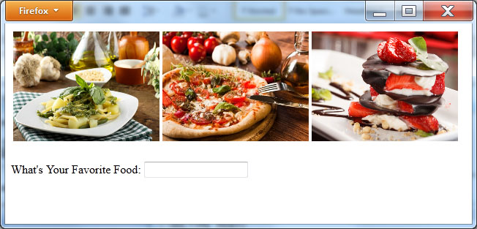
Putting content into the form
<!DOCTYPE html> <html> <body> <form action="http://www.WebsiteDevelopmentBook.com/FormEcho.php" method="post"> <table> <tr> <td><img src="http://www.websitedevelopmentbook.com/chapter06/Pasta.jpg" width="200" height="150"/></td> <td><img src="http://www.websitedevelopmentbook.com/chapter06/Pizza.jpg" width="200" height="150"/></td> <td><img src="http://www.websitedevelopmentbook.com/chapter06/Dessert.jpg" width="200" height="150"/></td> </tr> </table> <br/> What's Your Favorite Food: <input type="input" name="food"/> </body> </html>

Slide 10
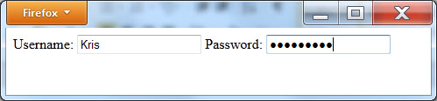
Prompting for a password
<!DOCTYPE html> <html> <body> <form action="http://www.WebsiteDevelopmentBook.com/FormEcho.php" method="post"> Username: <input type="input" name="username"/> Password: <input type="password" name="userPassword"/> </body> </html>

Slide 11
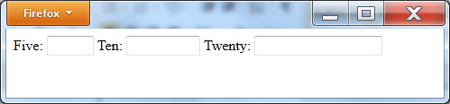
Specifying field max lengths
<!DOCTYPE html> <html> <body> <form action="http://www.WebsiteDevelopmentBook.com/FormEcho.php" method="post"> Five: <input type="input" maxlength="5" size="5"/> Ten: <input type="input" maxlength="10" size="10"/> Twenty: <input type="input" maxlength="20" size="20"/> </form> </body> </html>

Slide 12
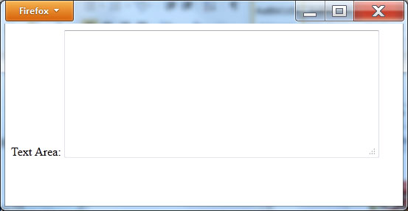
Using a textarea for larger input
<!DOCTYPE html> <html> <body> <form action="http://www.WebsiteDevelopmentBook.com/FormEcho.php" method="post"> Text Area: <textarea rows="10" cols="50"></textarea> </form> </body> </html>

Slide 13
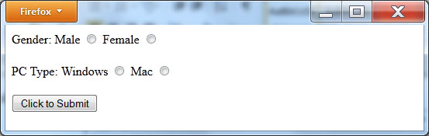
Radio buttons
<!DOCTYPE html> <html> <body> <form action="http://www.WebsiteDevelopmentBook.com/FormEcho.php" method="post"> Gender: Male <input type="radio" name="gender" value="male"/> Female <input type="radio" name="gender" value="female"/> <br/> <br/> PC Type: Windows <input type="radio" name="PC" value="Windows"/> Mac <input type="radio" name="PC" value="Mac"/> <br/> <br/> <input type="submit" value="Click to Submit"/> </form> </body> </html>

Slide 14
Selecting a default radio button
Male <input type="radio" name="gender" value="male" checked/>
Female <input type="radio" name="gender" value="female"/>

Slide 15
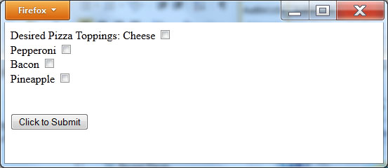
Checkboxes
<!DOCTYPE html> <html> <body> <form action="http://www.WebsiteDevelopmentBook.com/FormEcho.php" method="post"> Desired Pizza Toppings: Cheese <input type="checkbox" name="cheese"/><br/> Pepperoni <input type="checkbox" name="pepperoni"/><br/> Bacon <input type="checkbox" name="bacon"/><br/> Pineapple <input type="checkbox" name="pineapple"/><br/> <br/> <br/> <input type="submit" value="Click to Submit"/> </form> </body> </html>

Slide 16
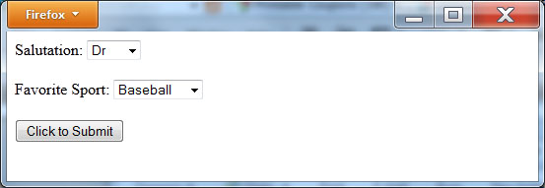
Pull-down lists
<!DOCTYPE html> <html> <body> <form action="http://www.WebsiteDevelopmentBook.com/FormEcho.php" method="post"> Salutation: <select name=“salutation”> <option>Dr</option> <option>Mr</option> <option>Mrs</option> <option>Miss</option> <option>Ms</option> </select> <br/><br/> Favorite Sport: <select name=“sport”> <option>Baseball</option> <option>Basketball</option> <option>Football</option> <option>Hockey</option> <option>Soccer</option> </select> <br/><br/> <input type="submit" value="Click to Submit"/> </form> </body> </html>

Slide 17
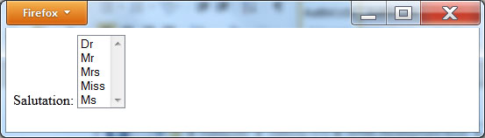
Pull-down list size
Salutation: <select name=“salutation” size= 5’>

Slide 18
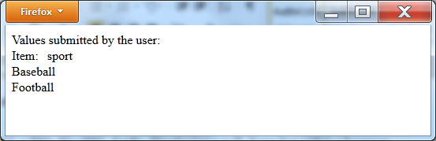
Selecting multiple elements
Favorite Sport: <select name=“sport[]” multiple> <option>Baseball</option> <option>Basketball</option> <option>Football</option> <option>Hockey</option> <option>Soccer</option> </select>

Slide 19
Resetting a form’s contents
<!DOCTYPE html> <html> <body> <form action="http://www.WebsiteDevelopmentBook.com/FormEcho.php" method="post"> Name: <input type="input" name="name"/><br/> Phone: <input type="input" name="phone"/><br/> Programming Languages: C <input type="checkbox" name="C"/><br/> Java <input type="checkbox" name="Java"/><br/> VB <input type="checkbox" name="VB"/><br/> <br/><br/> <input type="submit" value="Click to Submit"/><input type="reset" value="Reset"/> </form> </body> </html>

Slide 20
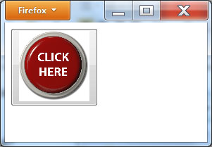
Creating a custom button
<!DOCTYPE html> <html> <body> <form action="http://www.WebsiteDevelopmentBook.com/FormEcho.php" method="post"> <button type="submit"> <img src="http://www.WebsiteDevelopmentBook.com/Chapter06/click.jpg" height="100" width="100" /> </button> </form> </body> </html>

Slide 21
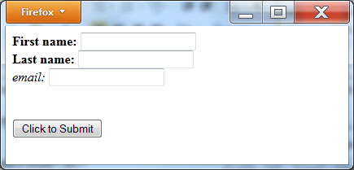
Using field labels
<!DOCTYPE html> <html> <body> <form action="http://www.WebsiteDevelopmentBook.com/FormEcho.php" method="post"> <label for="firstname"><b>First name:</b> </label> <input type="text" id="firstname"><br/> <label for="lastname"><b>Last name: </b></label> <input type="text" id="lastname"><br/> <label for="email"><i>email:</i> </label> <input type="text" id="email"><br/> <br/><br/> <input type="submit" value="Click to Submit"/> </form> </body> </html>

Slide 22
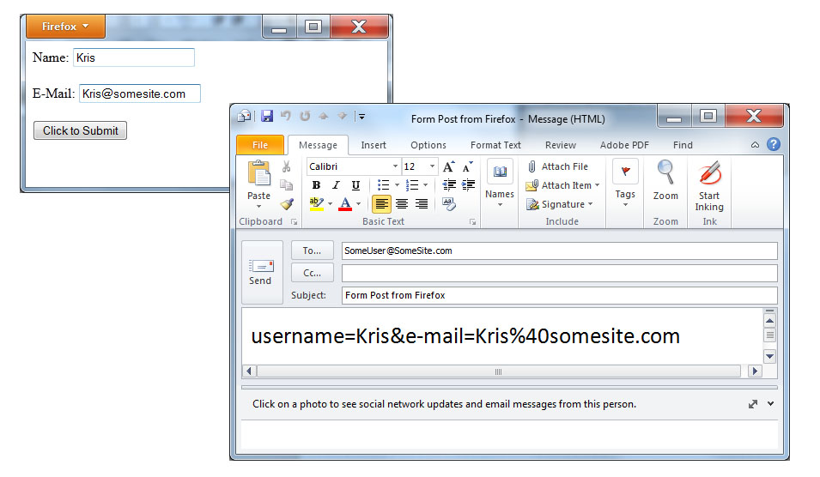
E-mailing a form’s contents
<!DOCTYPE html> <html> <body> <form action="mailto:SomeUser@SomeSite.com" method="post"> Name: <input type="input" name="username"/> <br/><br/> E-Mail: <input type="input" name="e-mail"/> <br/><br/> <input type="submit" value="Click to Submit" /> </form> </body> </html>

Slide 23
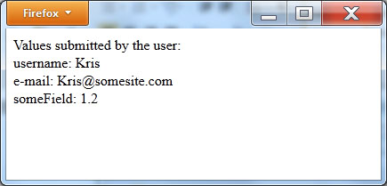
Hidden form fields
<!DOCTYPE html> <html> <body> <form action="http://www.WebsiteDevelopmentBook.com/FormEcho.php" method="post"> Name: <input type="input" name="username"/> <br/><br/> E-Mail: <input type="input" name="e-mail"/> <br/><br/> <input type="hidden" name="someField" value="1.2"/> <input type="submit" value="Click to Submit" /> </form> </body> </html>

Slide 24
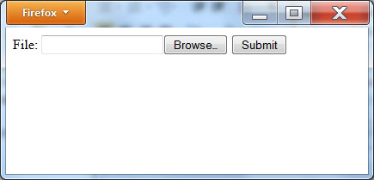
Uploading a file
<!DOCTYPE html> <html> <body> <form action="http://www.WebsiteDevelopmentBook.com/Chapter06/FileUploader.php" enctype="multipart/form-data" method="post"> File: <input type="file" name="file" id="file"/> <input type="submit" value="Submit" /> </form> </body> </html>

Slide 25
Processing a file upload with php
<?php if ($_FILES["file"]["error"] > 0) { echo "Error: " . $_FILES["file"]["error"] . "<br />"; } else { echo "Upload: " . $_FILES["file"]["name"] . " successful<br />"; echo "Stored in: " . $_FILES["file"]["tmp_name"]; } ?>

Slide 26
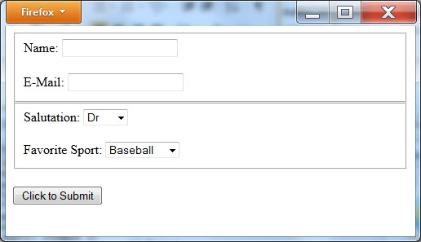
Grouping fields
<!DOCTYPE html> <html> <body> <form action="http://www.WebsiteDevelopmentBook.com/FormEcho.php" method="post"> <fieldset> Name: <input type="input" name="username"/> <br/><br/> E-Mail: <input type="input" name="e-mail"/> </fieldset> <fieldset> Salutation: <select name=“salutation”> <option>Dr</option> <option>Mr</option> <option>Mrs</option> <option>Miss</option> <option>Ms</option> </select> <br/><br/> Favorite Sport: <select name=“sport”> <option>Baseball</option> <option>Basketball</option> <option>Football</option> <option>Hockey</option> <option>Soccer</option> </select> </fieldset> <br/> <input type="submit" value="Click to Submit" /> </form> </body> </html>

Slide 27
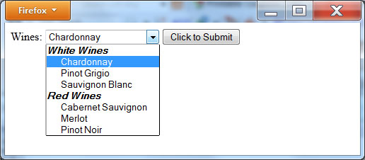
Grouping list selections
<!DOCTYPE html> <html> <body> <form action="http://www.WebsiteDevelopmentBook.com/FormEcho.php" method="post"> Wines: <select name=“wine”> <optgroup label="White Wines"> <option>Chardonnay</option> <option>Pinot Grigio</option> <option>Sauvignon Blanc</option> </optgroup> <optgroup label="Red Wines"> <option>Cabernet Sauvignon</option> <option>Merlot</option> <option>Pinot Noir</option> </optgroup> </select> <input type="submit" value="Click to Submit" /> </form> </body> </html>

Slide 28
Real world: form validation
<!DOCTYPE html> <head> <script> function validateForm() { if (document.forms["myForm"]["name"].value==null || document.forms["myForm"]["name"].value=="") { alert("Name must be filled out"); return false; } if (document.forms["myForm"]["phone"].value==null || document.forms["myForm"]["phone"].value=="") { alert("Phone must be filled out"); return false; } if (document.forms["myForm"]["email"].value==null || document.forms["myForm"]["email"].value=="") { alert("Email must be filled out"); return false; } return true; } </script> </head> <html> <body> <form name="myForm" action="http://www.WebsiteDevelopmentBook.com/FormEcho.php" method="post" onsubmit="return validateForm()" > Name: <input type="text" name="name" /><br/> Phone: <input type="text" name="phone" /><br/> E-mail: <input type="text" name="email" /><br/> <input type="submit" value="Click to Submit" /> </form> </body> </html>

Slide 29
Summary
Depending on the processing a Web page performs, it is common for the page to require user input of some type. To perform such input operations, HTML pages use forms.
Across the Web, sites use forms to prompt the user for login credentials, to request registration data, to get credit card and shipping information, and much more.
You use the <form> and </form> tag pair to define a form and the <input> tag to create the most common form input fields.
To perform form processing normally requires that one developer use HTML tags to create the form and that a second developer create scripts, using PHP or another scripting language, which process the data on the remote server.

